Slide 1

Stefan Kühn and Sheena Yoon Research Department, International Labour Organization
Female labour force participation around the world: trade-offs between preferences, gender norms, and socioeconomic constraints

Slide 2
Introduction
Gender gaps persist and slowdown of progress in the recent decade
Indicates that women are still facing a multiplicity of constraints restricting their capabilities and freedoms to access the labour market
ILO-Gallup survey finding: 70 per cent of women around the world in 2016 prefer to work a paid job (despite their labour market status)
Analysis of ILO-Gallup survey questions designed to capture the perception and opinions of women about their position in the labour market
Some references: Besamusca et al. 2015, Klasen and Pieters 2012, Mammen and Paxson 2000, Uysal 2004
Notes:
Large gaps in participation remain despite improvements in education, technology, health, declining fertility, and changing social norms
The past decade has shown a slowdown in closing the gaps
ILO-Gallup:
- The evidence is then even more clear when approximate half of all women are out of the labour force.
-58 per cent for those out of the labour force express their preference to work a paid job. Still a majority.

Slide 3
What are we doing?
Estimate female labour force participation
Contribution:
capture the voices of women in the world of work
global overview: 121 countries
age groups (life-cycle of women)
impact by different country groupings
quantify the impact of drivers on female labour force participation
How:
First, present baseline results of drivers of participation and then observe how the impact differs across the life-cycle by testing where interactions are significant, thus defining the model
Notes:
Given the differences in participation according to life-cycle circumstances, we present baseline results for drivers and then observe how the impact differs across the life-cycle
Test where interactions are significant by using the constrast function, this helps define the models’ interactions

Slide 4
Conceptual Framework
Life-cycle circumstances
gender, family status, age, disability, ethnicity, citizenship, sexual orientation, gender identity
INFLUENCE
AFFECT
Gender roles
Family, society, community, unequal care and household demands
Educational and vocational training
Social
Norms
SHAPE
SHAPE
Personal preferences
Self-identity, individuality, agency, choice, freedom
DETERMINE
DETERMINE
Labour market outcomes
Socio-economic constraints
Legal and policy framework, discrimination, macroeconomic conditions, access to care, poverty, infrastructure
Fundamental Drivers
Notes:
To visualize and conceptualize how a decision to participate is shaped and determined:
Personal Preferences→ is an expression of what is perceived to be legitimate in a woman’s personal circumstance and her socialized identity.
ex/ some women prefer to stay at home bc childcare costs may exceed their potential incomes or their role in the household is perceived as more valuable
Socioeconomic constraints → downturn in the business cycle can provoke economic necessity in households, provoking the “added-worker” affect moving more women into paid employment.
- potential returns to labour market, determines the opportunity cost of not working
- Their labour supply often acts as an insurance mechanism
- ex/ taxation on secondary earners can discourage
- discrimination in pay or treatment discouraged
- institutional framework shape these socioeconomic constraints while simultaneously reinforcing prevailing norms
** Gender gaps in labour market can reinforce one another and affect even the decision to participate. Most importantly, the decision to participate is hardly ever unconditional…especially when “women divide their time between household work, child rearing, home making, family enterprises, and the formal or informal labor market” **

Slide 5
hypothesis
Children (–)
Household #
Marriage (–)
Age (inverted u-shaped)
Poverty (+)
No food or shelter
Gender roles (–)
Religion, household acceptability, urban/rural
Preferences (+)
Education (+)
Challenges (–)
ICT (+)
Religion (-)
Outlook (+)
Life evaluation of socio-economic conditions
Notes:
Challenges, such as work-family balance.

Slide 6
Data Description
2016 Gallup World Poll, microdata covering 149,000 persons in 142 countries → Sample: 60,408 women, 121 countries
ILO-Gallup joint survey designed 4 specific questions:
Would you PREFER to work at a paid job, or stay at home and take care of your family or both?
It is perfectly acceptable for any woman in your family to have a paid job outside the home IF SHE WANTS ONE. Do you agree?
Please think about women who work at paid jobs in [country/territory name] today. What do you think is the BIGGEST challenge these women face?
If a woman has similar education and experience to a man, does she have a better opportunity, the same opportunity, or a worse opportunity to find a good job in the city or area where you live?
Notes:
1) 500 women per country
In addition to being asked a whole range of issues and characteristics such as poverty, age, family status, education, religion…specific questions designed by ILO are included
GALLUP methodology: globally representative survey

Slide 7
Majority of women prefer to work a paid job, despite labour market status
Source: ILO-Gallup
Globally, 70 per cent of women prefer to work a paid job despite their labour market status. While, 59 per cent of women outside the labour market would prefer to work at paid jobs.
Notes:
2016 Gallup World Poll, microdata covering 149,000 persons in 142 countries
ILO-Gallup joint survey designed 4 specific questions:
Would you PREFER to work at a paid job, or stay at home and take care of your family or both?
It is perfectly acceptable for any woman in your family to have a paid job outside the home IF SHE WANTS ONE. Do you agree?
Please think about women who work at paid jobs in [country/territory name] today. What do you think is the BIGGEST challenge these women face?
If a woman has similar education and experience to a man, does she have a better opportunity, the same opportunity, or a worse opportunity to find a good job in the city or area where you live?

Slide 8
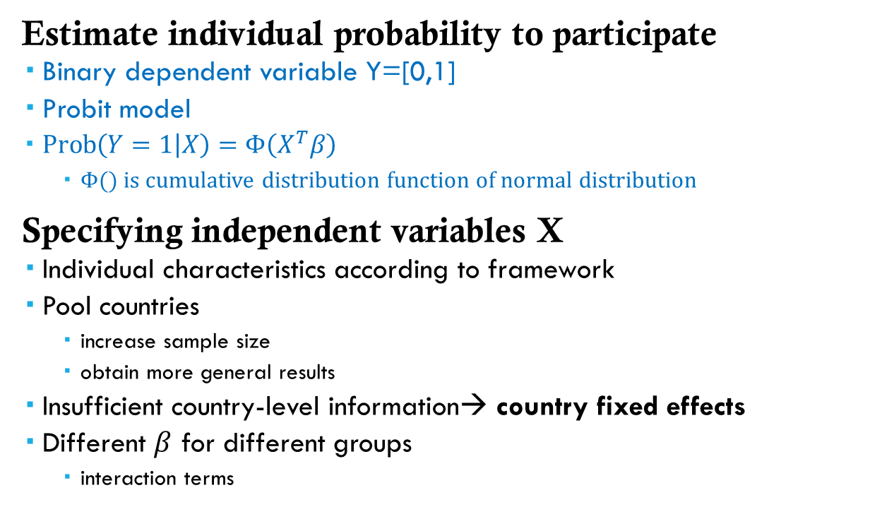
Empirical methodology I
Estimate individual probability to participate
Binary dependent variable Y=[0,1]
Probit model
$\operatorname{Prob}\left(Y=1 | X\right)=Φ\left(X^{T}β\right)$
$Φ()$ is cumulative distribution function of normal distribution
Specifying independent variables X
Individual characteristics according to framework
Pool countries
increase sample size
obtain more general results
Insufficient country-level information→ country fixed effects
Different $β$ for different groups
interaction terms
Notes:
*We know these groups are different and to take that into account, we use interaction terms to get group-specific coefficents.
We create different groups, they are so different that their coeofficents are different. Hence, Interaction terms account for the different coeffficients of different groups.

Slide 9
Empirical methodology II
Group by age to account for life-cycle effects
Young (15-24)
Prime age (25-54)
Older (55+)
Group by countries
Low income
Non-low income with low LFPR gap
Non-low income with high LFPR gap
Interact both with all variables
Notes:
Classification based on hypothesis that fundamental drivers have a differential affect depending on the life-cycle of a woman and the environment in which she lives in.

Slide 10
Empirical methodology IV
Compute average marginal effect
Taking all other variables at actual value
Compute cumulative conditional effect
Compute lowest probability to work by setting variables at respective values
For non-poor women
Reverse values of variables by category of drivers, one at a time
See conditional marginal effect of categories
Notes:
You compute the marginal change in the probability change for each individual, which is computed as the overall average change of all individuals
Respective value: For example, a woman has children, married, does not have access to communication.
What contributes to female LFPR…so we

Slide 11
Unconditional marginal impact of drivers on the
probability to participate in the labour market
 | Prime-age, Low gap countries
Personal preference
Prefer paid work | 0.18***
Socio-economic constraints
Poverty | -0.01
Positive outlook of opportunities | 0.00
Negative outlook of opportunities | 0.00
Optimism | 0.06***
Married/partner | -0.03***
Children | -0.04***
Jobs Climate | 0.00
Communications | 0.00
Law & Order | -0.0
Roads | -0.01
Gender role conformity
Urban | 0.01
Acceptability | 0.04***
Religion: Islam | -0.07***
Education
Secondary education | 0.06***
Tertiary education | 0.13***
Observations | 16,046
results
Preferences matter
Tertiary education has the second largest impact
Marriage and children negatively affects prime-age working women, highlighting their disproportionate care demands
Household acceptability of women working has a positive affect
Religion has a negative affect

Slide 12
Life-cycle effects
Notes:
Joint marginal impact contrast, differential life-cycle affects across regions: 2-3 graphs
Significant difference:
(Low gap vs High gap) (Age 15-24 vs Age 25-54)
(Low gap vs High gap) (Age 55+ vs Age 25-54)
(Developing country vs High gap) (Age 15-24 vs Age 25-54)

Slide 13
Reported challenges in the Labour Market
Age group proportions and estimated coefficients, 2016
www.ilo.org/weso
Notes:
UPDATE FOR ACROSS AGE GROUPS, LOW GAP?
Highlight where significance of differences depend on life-cycle circumstance,
Marginal impact
Lack of work flexibility is treated as the base,

Slide 14
Life-cycle effects: Relationship status
Notes:
Joint marginal impact contrast, differential life-cycle affects across regions: 2-3 graphs
Significant difference:
(Low gap vs High gap) (Age 15-24 vs Age 25-54)
(Low gap vs High gap) (Age 55+ vs Age 25-54)
(Developing country vs High gap) (Age 15-24 vs Age 25-54)

Slide 15
Life-cycle effects: Education
Notes:
Particularly pronounced affect of secondary education for those in developing and older.

Slide 16
Life-cycle effects: Education

Slide 17
Conclusion
Preferences matter, but other constraints set by gender roles and socioeconomic conditions have a greater trade-off. Shown by cumulative effects.
Considerable interconnectivity and interdependence among drivers
The challenges women face have a considerable affect on their decision to participate suggesting targeted efforts necessary to address constraints set by gender roles and socio-economic conditions.
Depending on the position of the woman in the life-cycle, the magnitude of effects differ. Also, in regards to the environment she inhabits.
Notes:
Impact of preferences is smaller when doing cumulative than marginal effects. Which show that preferences by themselves…there is a trade-off.

Slide 18
Thank you

